Slide 1
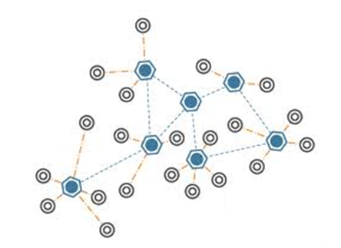
Wireless Sensor Networks: Perimeter Security
By Jeremy Prince, Brad Klein, Brian Wang, & Kaustubh Jain

Slide 2
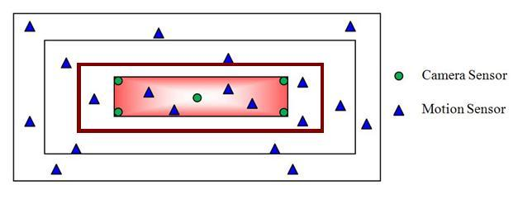
Project Description
Track and monitor intruders within the network.
Both camera sensors and motion sensors will be used.
Motion sensors are deployed in the whole area we are interested.
Camera sensors are only deployed in the security area.
The interested area is divided into layers for the sake of energy efficiency.

Slide 3
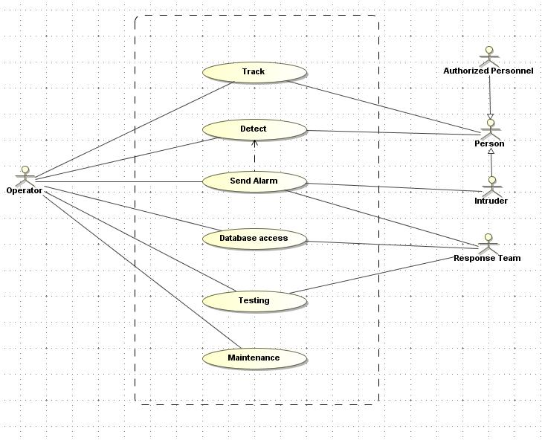
Use Case Diagram

Slide 4
Detect
Description: The motion sensors realize a person in within the network, or the camera sensors take picture
Primary Actors: Operator
Pre-Conditions: The sensor has been woken up by its neighbor, and the person is within its detection range. The threshold for motion sensors is pre-configured.
Flow of Events:
The motion sensor receives the IR signal of the object and processes it. If the signal exceeds the pre-defined threshold, then the object is considered to be a person.
The motion sensor transitions to the Active Mode.
The motion sensor notifies its neighbors.
The motion sensor generates the packet with the location of the person and sends the packet toward the Operator.
Sensors receiving the packet destined for the Operator wake up, resend the packet, and the goes back to sleep. The sensor receiving both wakeup signal and packet, stays in standby.
The camera sensor takes the picture
The camera sensor generates the packet with the picture of the person and sends the packet to the Control Center/Operator.
Alternate Flow of Events: None
Post Conditions: The packet has been sent to the Control Center. The neighbors of the motion sensor have switched to the Standby Mode (motion sensor) or the Active Mode (camera sensor)
Assumptions:
Quality of the picture will depend on the environment (time of day, air quality, etc.).
Even if the intruder has moved out of the frame / field of view, a picture will be taken.
The wake-up time for sensors should be short enough (negligible compared to the movement of the person).
Waking up to send packet requires minimal power (negligible)
Each sensor knows who its neighbors are, and processes the packets accordingly.
New Requirements:
The camera sensor has enough local memory to store the picture.
The threshold results in low missed detections and low false detections.
The sensor has an appropriate re-detection rate
The location has lights for night time.

Slide 5
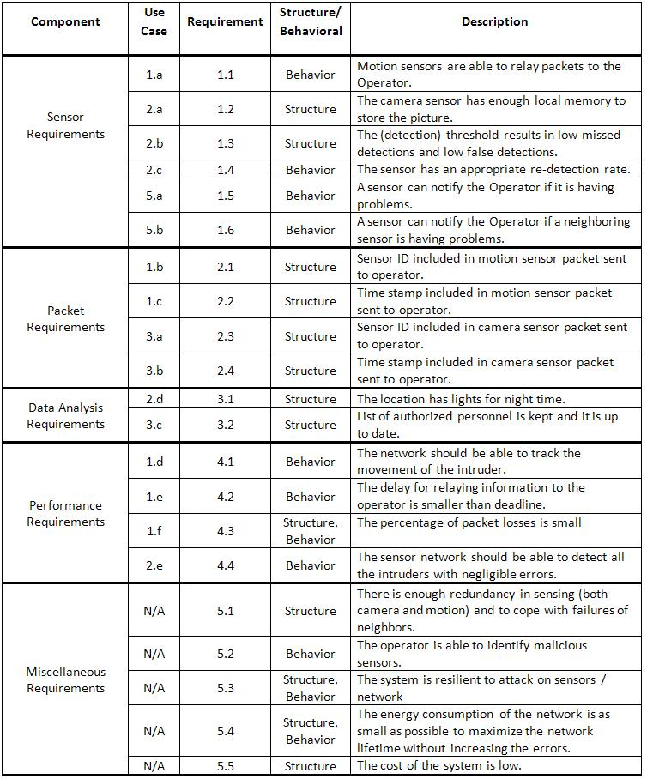
Sensor Requirements

Slide 6
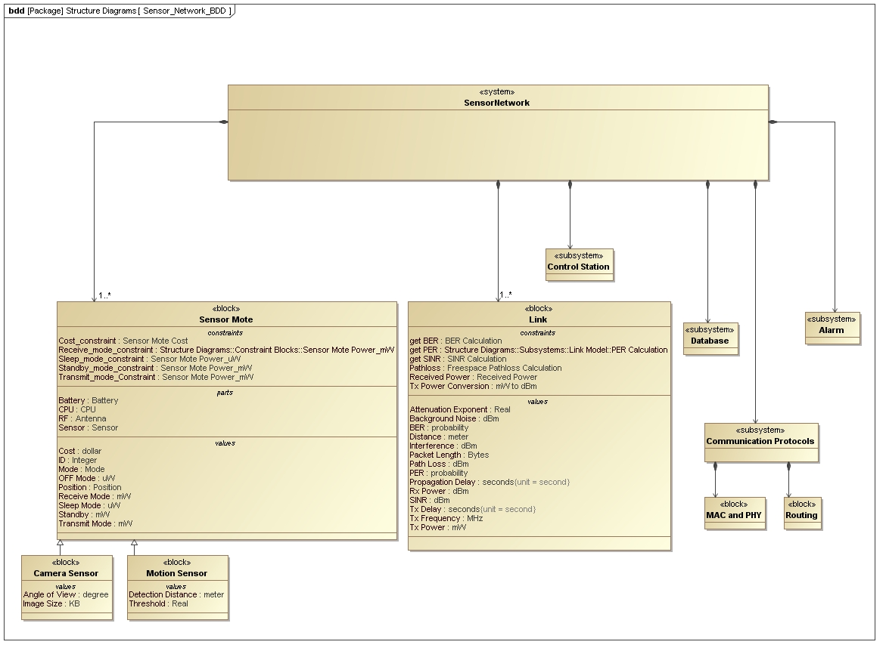
Block Diagram for Sensor Network

Slide 7
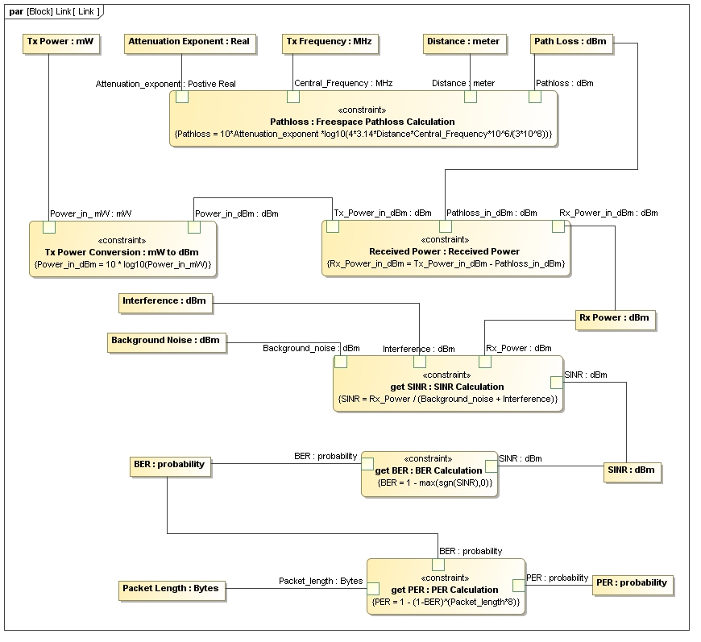
Parametric Diagram for Link

Slide 8
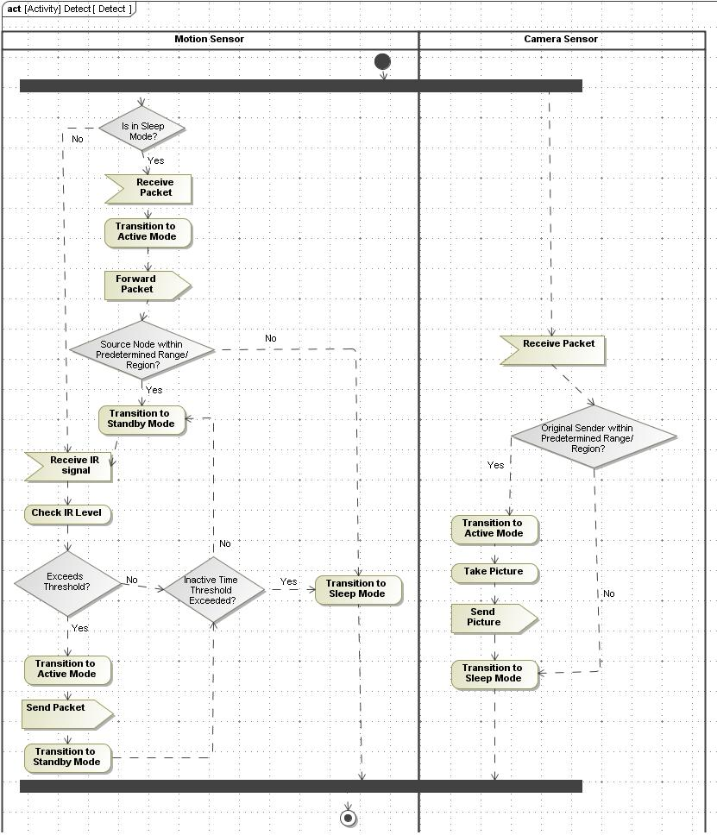
Detect Activity Diagram

Slide 9
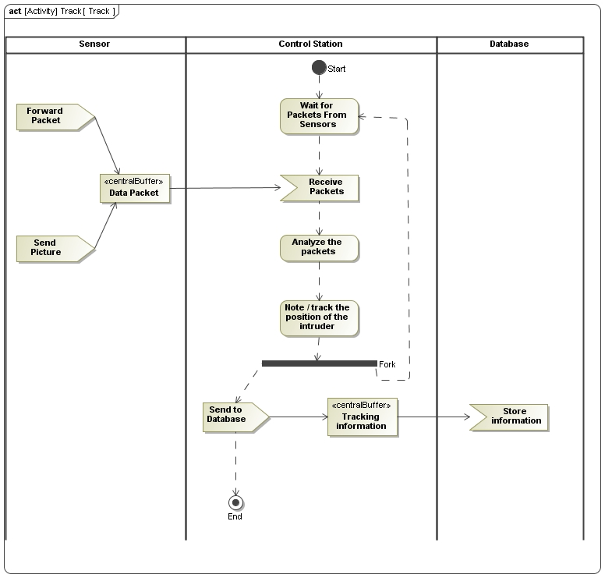
Track Activity Diagram

Slide 10
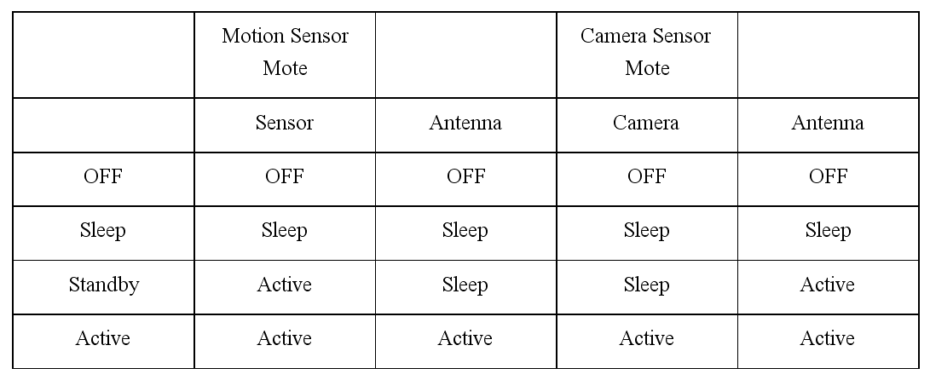
State Diagram

Slide 11
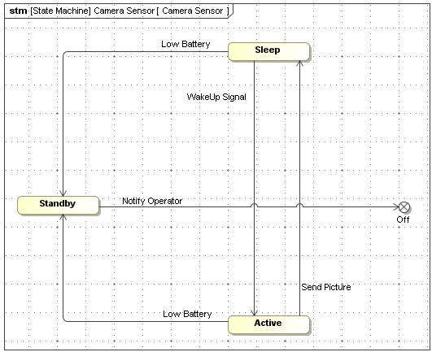
State Diagram – Camera Sensor

Slide 12
Trade-Off Analysis
Performance Metrics - Probability of Missed Detection, Energy Consumption and Costs.
Design Parameters - Number of sensors, time the sensors stay awake once woken-up.
Trade-offs
Increasing the time sensors stay awake decreases the probability of missed detections, but increases energy consumption.
Increasing the number of sensors will decrease the probability of missed detection, but increase the costs.
Data Sheet
Antenna (CC2420) Standby mode: 426 uA * 3.6 V Sleep mode: 20 uA * 3.6 V Transmit mode: 17.4 mA * 3.6 V Receive mode: 19.7 mA * 3.6 V Transmit Bit Rate: 256 kbps P = 0 dBm cost: $ 100
CPU (PXA 271)

Slide 13
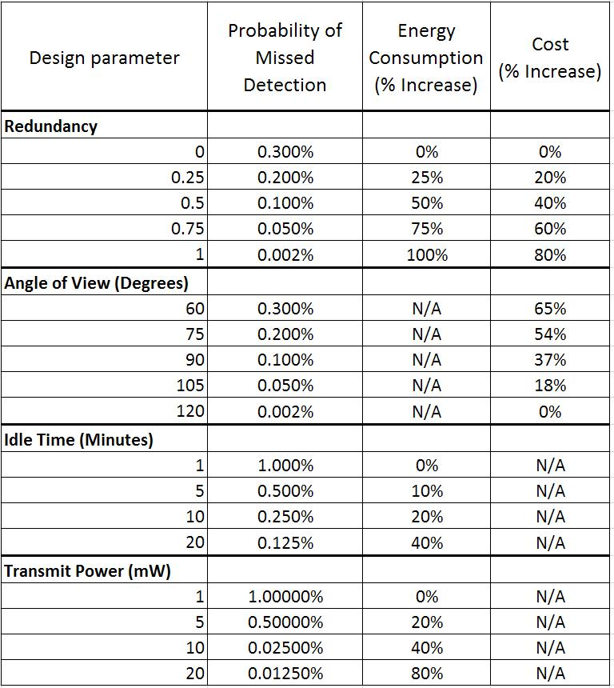
Trade-off Analysis Table

Slide 14
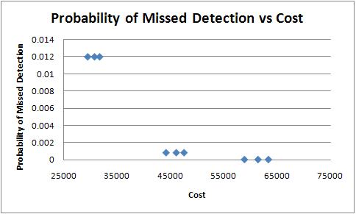

Slide 15
R = Redundancy Factor A = Camera Sensor Field of View Angle St = Stand By Time P = Transmit Power of Antenna

Slide 16
Test and Validation
Use UPPAAL to verify the state transitions for the motion and camera sensors with timing information and that there are no deadlocks.
Verify by inspection that the component level-requirements are met.
Verify each sensor is individually working properly
motion sensor senses motion in its vicinity; the detection threshold is set appropriately.
camera sensor captures good quality picture.
sensors change their states according to proper timing or event-triggers.
Test functionality of subsystems
alarm subsystem generates alarm.
database stores pictures and responds to queries by the controller.
controller properly authenticates a picture of a authorized personnel captured by one of the camera sensors.
Test system level requirements by trial runs with a dummy intruder.
The system detects the entry
Sensors send and forward messages appropriately
Sensors change state properly
The controller correctly tracks the motion of the intruder
Camera sensors capture picture.
Testing of sensor failure scenarios (security and resilience to failure)
Sensors generate low battery signal appropriately.
Other sensors detect loss of neighboring sensors, notify the controller and modify their functionalities accordingly.
Controller keeps track of failed sensors
Controller analyzes data to identify malicious sensor.
Controller sends alarm if too many sensor nodes compromised.
Verifying performance requirements are met through analysis
Using parametric diagrams, and solvers like Mathematica and Matlab, compute the performance metrics and verify the margin of error from performance requirements.

